Slide 1
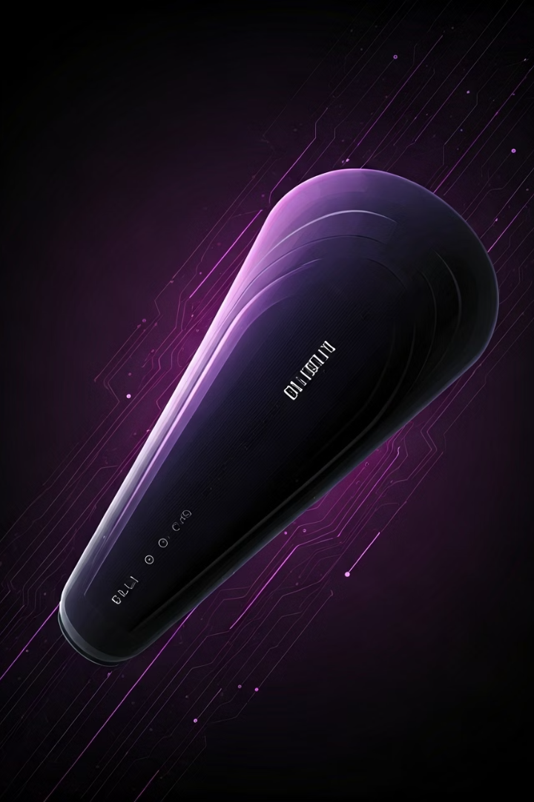
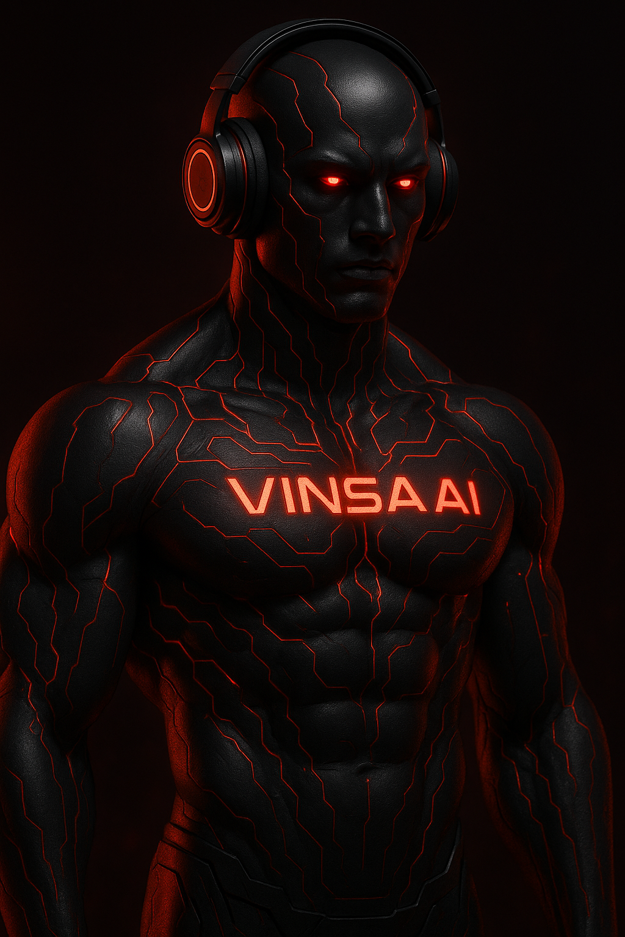

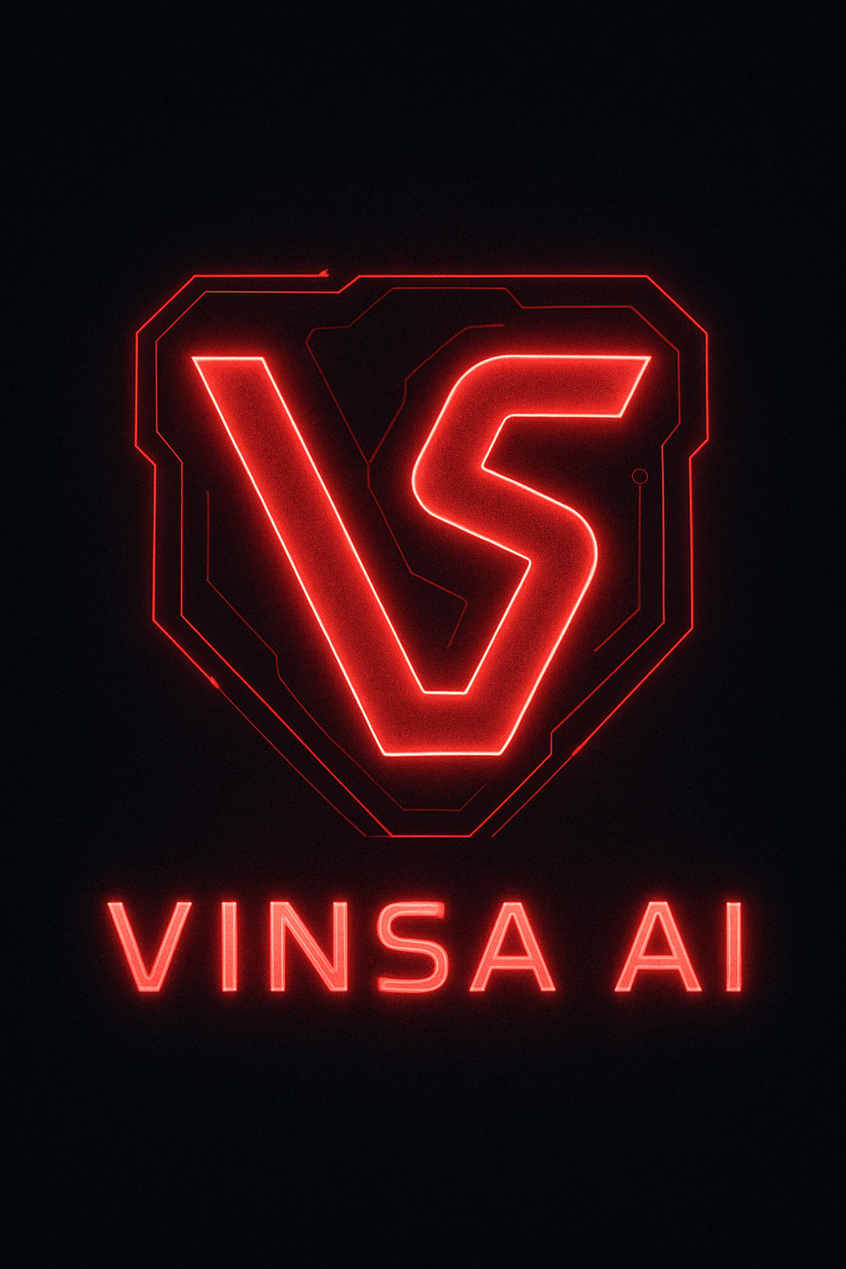
Vinsa-Fit.ai: AI Fitness Revolution
Harnessing AI for Personalized Fitness
Student Name: Lagishetti Vignesh
College Name: SR University
Department: Btech-CSE
Email ID: lvigneshbunty789@gmail.com
AICTE Student ID: STU6421a3121f96a1679926034
by Lagishetti Vignesh

Slide 2





Challenges in Fitness Accessibility
Access Barrier
80% lack personalized coaching due to location or cost.
Generic Solutions
73% dropout rate for one-size-fits-all programs.
Time Investment
5+ hours spent researching fitness options.
Injury Risk
65% of injuries from non-tailored fitness programs.

Slide 3





Vinsa-Fit.ai: Your AI Fitness Coach
Voice-Based AI Assistant
Gathers user information through natural dialogue.
Personalized Workout Generation
AI algorithms create tailored exercise programs.
Program Management System
Users create and store multiple fitness programs.
Custom Nutrition Planning
Personalized meal recommendations based on goals.
Futuristic User Interface
Cyberpunk-inspired responsive design for usability.

Slide 4





Key Advantages of Vinsa-Fit.ai
Quick Program Creation
Complete Personalization
Expertise Accessibility
Professional fitness knowledge for everyone, democratized.
Personalization in under 5 minutes for swift starts.
100% tailored programs for optimal individual results.
Safety-First Protocols
Avoids harmful exercises, prioritizing user well-being.

Slide 5

Technology Stack for Vinsa-Fit.ai
Frontend Development Tools
Next.js, React, and Tailwind CSS for responsive UI.
Backend Services Utilized
Azure Cognitive Services and Azure AI Vision enhance functionality.
Voice AI Integration
Vapi Platform provides advanced conversational AI capabilities.
Data Management Solutions
Convex and Clerk for efficient data handling and secure user authentication.

Slide 6

Key Algorithms in Vinsa-Fit.ai
User Profile Analysis
Nutrition Planning
Algorithm processes user inputs for fitness parameters.
Calculates caloric needs and macro distribution for users.
1
2
3
Workout Generation
Develops algorithm for personalized workout plans.

Slide 7

Vinsa-Fit.ai Platform Overview
Personalized Workout Programs
Delivering tailored workouts for individual fitness goals.
Responsive Design Across Devices
Seamless functionality on various devices for user convenience.
Custom Nutrition Guidance
Complements workout routines for optimal results.

Slide 8



Vinsa-Fit.ai: A Game Changer
AI Fitness
1
Revolutionizing personalized fitness with AI technology.
Personalization
2
Tailored plans for unique user needs.
Accessibility
3
Democratizing expert fitness knowledge.

Slide 9




Future Scope of AI Fitness Solutions
Enhanced UX
1
Deeper Engagement
Exploring advanced AI for user experience.
2
Innovating to boost user interaction.
4
Predictive Health
Virtual Coaching
3
AI anticipates needs for proactive care.
Real-time, immersive guidance.

Slide 10
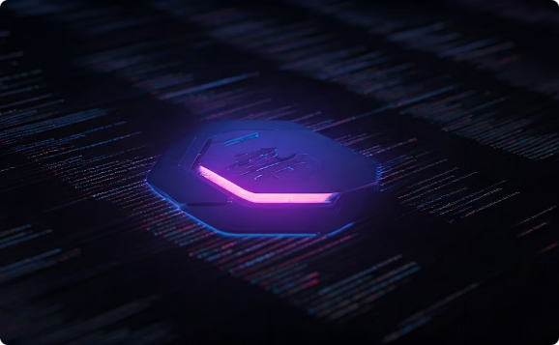
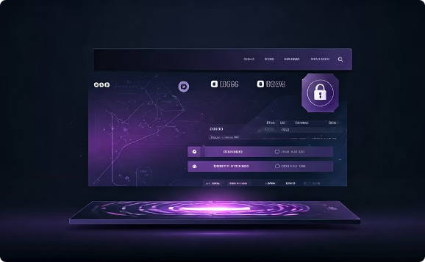
Project URL’s
GitHub Repository
Explore our project's source code. Contribute to future innovations
Github : https://github.com/buntyanvi/Vinsa-Fit.ai
Access the Platform
Experience personalized AI fitness. Start your journey today
Deployment Link : https://vinsa-fit-ai.vercel.app/

Slide 11
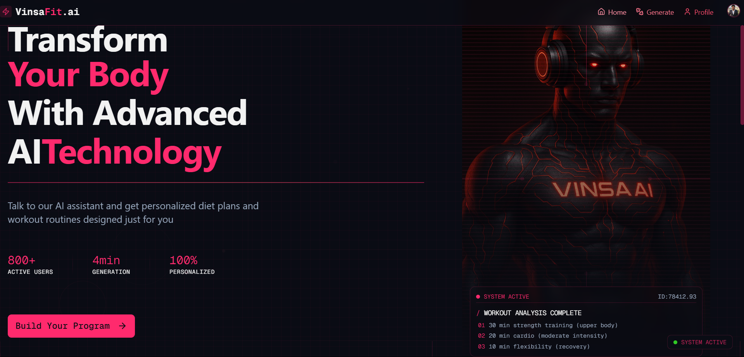
Result
Home Page
Footer

Slide 12
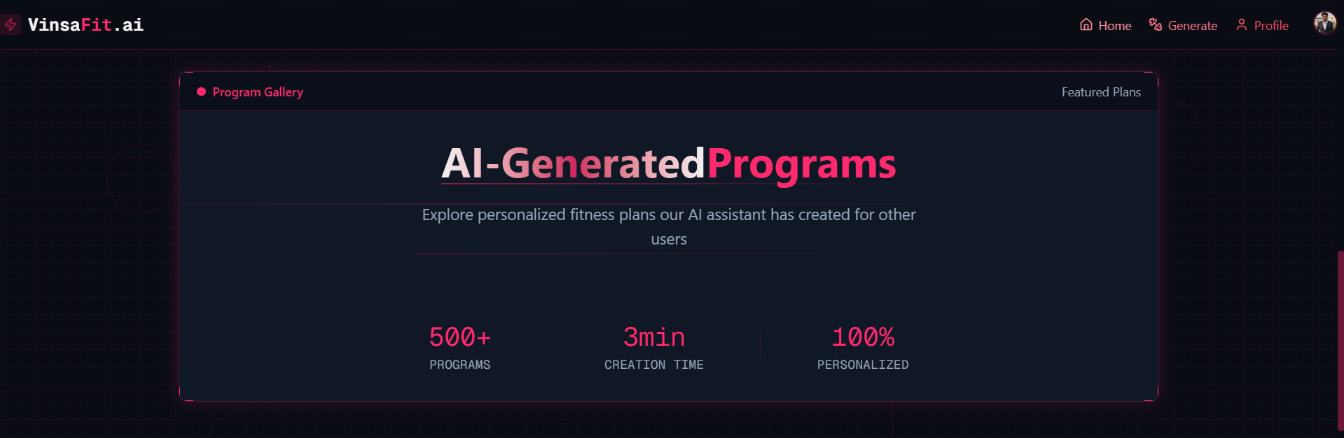
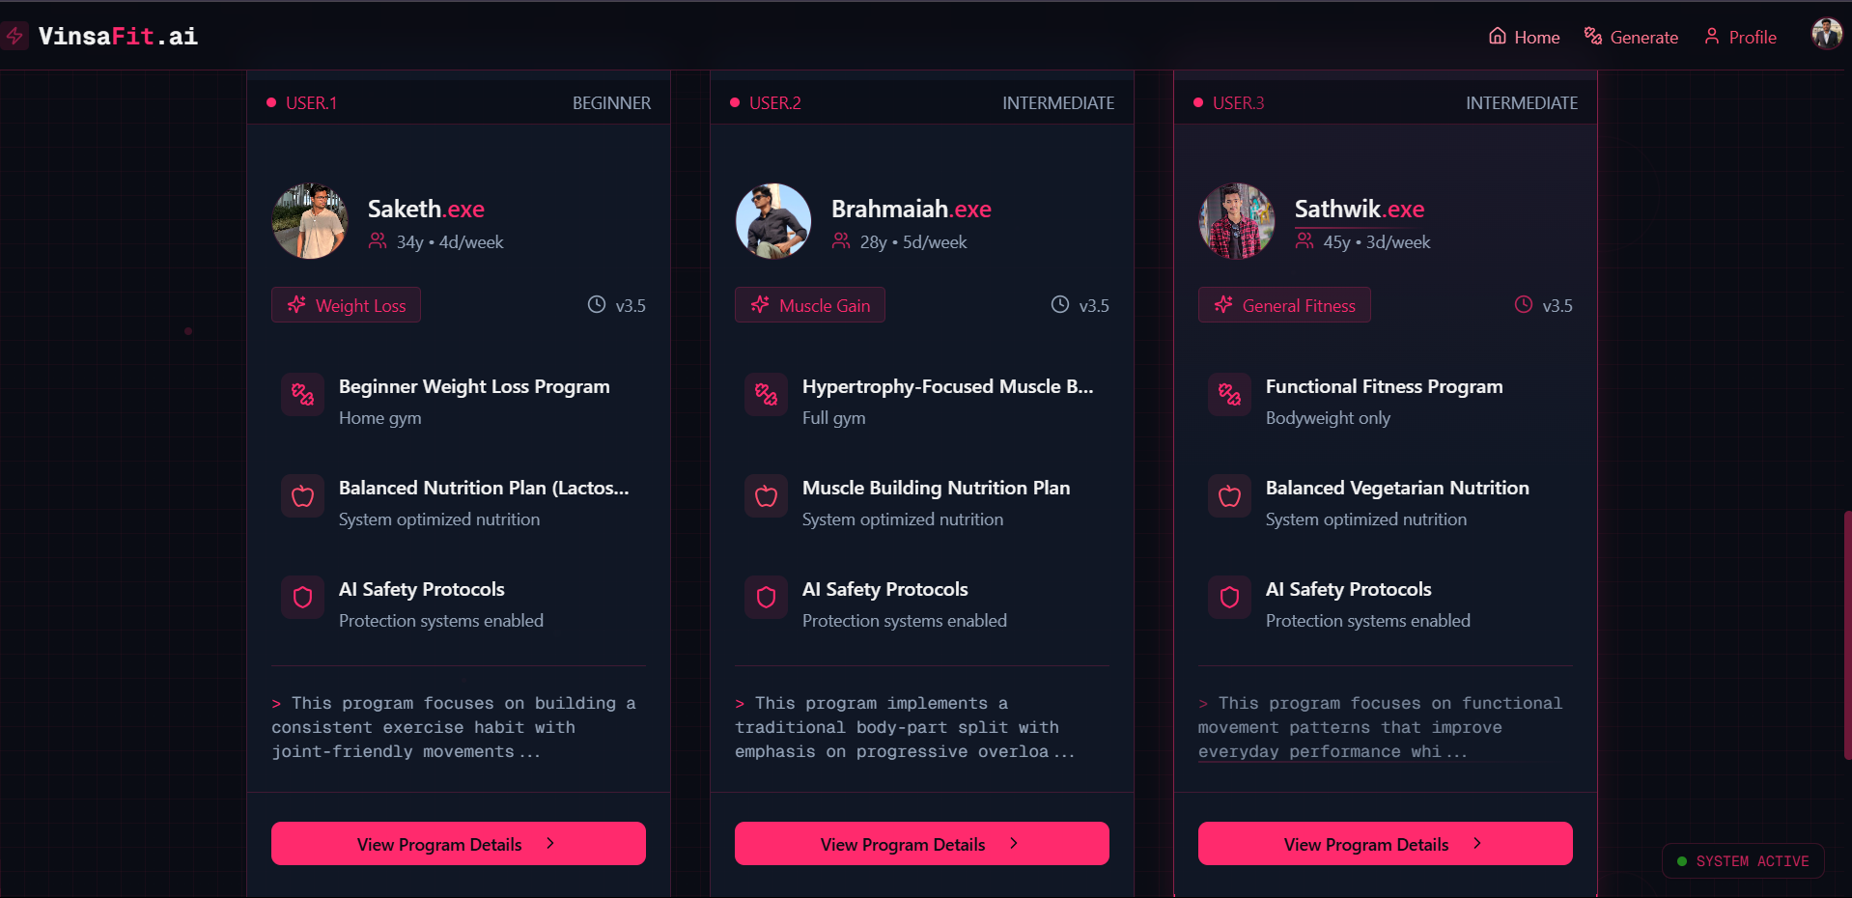
Result
Program Gallery
Users

Slide 13
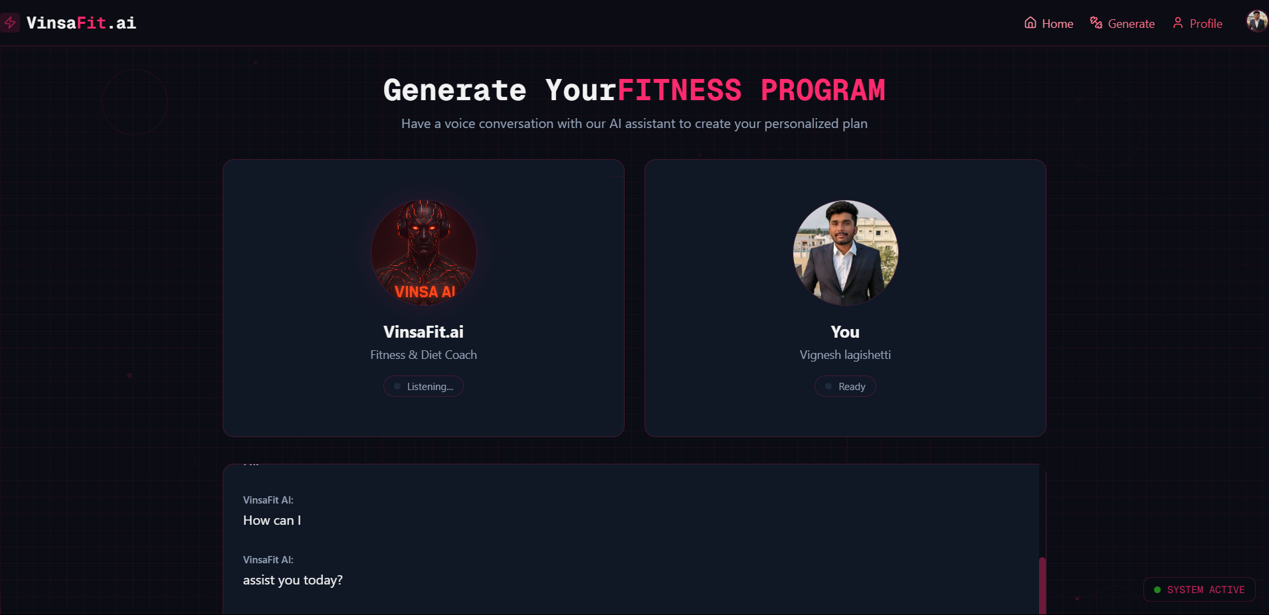
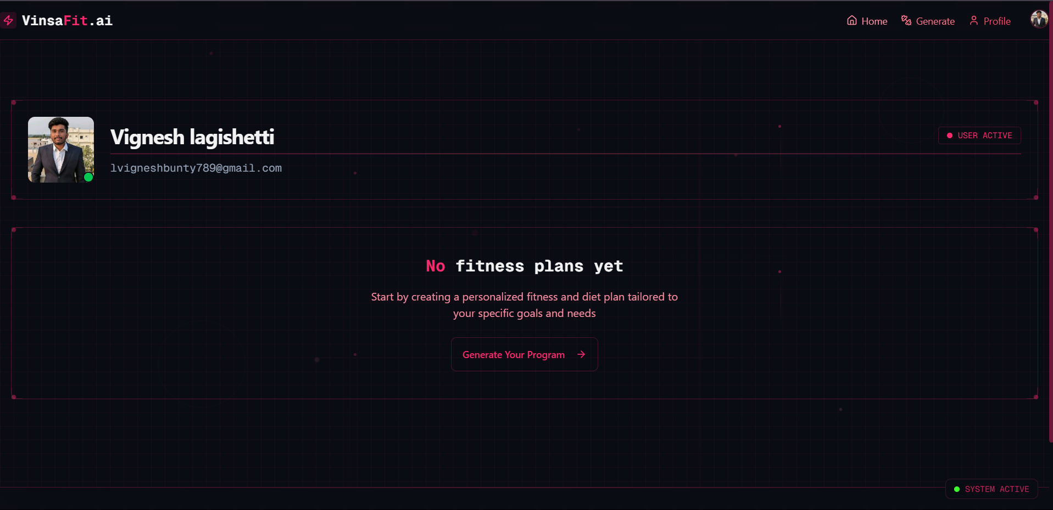
Result
Generate-Program
Profile Page

Slide 14

Join the Vinsa-Fit.ai Revolution
Transform Your Fitness Journey Today

